Slide 1
15IT413 – IT INFRASTRUCTURE MANAGEMENT
Unit-1: IT Infrastructure

Slide 2
DISCLAIMER
The contents of the slides are solely for the purpose of teaching students at SRM Institute of Science and Technology. All copyrights and Trademarks of organizations/persons apply even if not specified explicitly.

Slide 3
Topics
Introduction
Challenges in IT Infrastructure Management
Design Factors for IT Organizations and IT Infrastructures
IT Systems and Service Management Process
Information Systems Design Process
IT Infrastructure Library

Slide 4
Introduction
IT infrastructure of an organization comprises of equipment, software, hardware or any other components which are needed to deliver IT services to its customers.
It also provides a base on top of which program or project-specific systems and capabilities of an organization are created.
IT infrastructure can be divided into several categories such as:
1. Purchased software (e.g., ERP packages, RDBMS, operating systems, e-mail tools, office tools, financial applications, etc.)
2. IT infrastructure hardware (e.g., machines, desktops, servers, switches, communication devices, etc.)
3. Software development
4. Software maintenance (corrective, perfective, adaptive, block changes)
5. IT services (e.g., software setup, help desk, computer administration, etc.)
6. Human resource (working staff)

Slide 5
Introduction
IT infrastructure management aims to manage these components for effective utilization in order to provide better services to customers.
Almost all business activities of an organization depend upon the infrastructure.
Hence, its effective management is very essential.
IT infrastructure needs to be developed and managed in an active manner to support the requirements of the organization.
This is usually done by IT department of an organization in consultation with top management.
A good and reliable IT infrastructure is the key to the successful operations and is the foundation of any viable IT organization.
IT infrastructure management creates an infrastructure management environment that reduces IT complicacies.
It automates and supports required performance and service availability levels and resolves problems to ensure the business continuity.
As an organization scales its information technology (IT) infrastructure to support business growth, managing global networks, databases and applications becomes an important task.

Slide 6
Introduction
Among many other objectives, IT infrastructure management tries to:
1. Decrease the duplication of effort and increase organizational production
2. Decrease business risk
3. Ensure the use of standards
4. Ensure minimum downtime
5. Improve adaptability necessary for a changeable environment
6. Improve the information flow in information system
7. Ensure interoperability among organisational and external entities
8. Maintain effective change management policies and practices
9. Reduce operational costs
10.Increase service quality
11.Increase business planning

Slide 7
Introduction
IT skills and managerial practices also play an important role in IT infrastructure management
The below figure presents a view of IT infrastructure highlighting the importance of human element in it.
Three bottom layers of this figure show the IT infrastructure components where bottom-most layer depicts physical shared components such as computers and common technologies.
IT for Business
Human Resources
Shared IT Services
Physical Components

Slide 8
Introduction
The second bottom layer contains the commonly shared services such as database services and connections to internet.
The components of these two layers are changed into IT infrastructure services by human element using its skills, experience and knowledge.
The human element binds IT components into a reliable set of IT infrastructure services which are shared in business processes across the organization.
Good IT infrastructure management can avoid occurrence of IT infrastructure problems and resolve them before they impact business availability.
The management aspect of IT infrastructure is very critical since management practices are developed over time and they are unique for each organization.

Slide 9
Challenges - ITISM
IT infrastructure consists of resources and capabilities which are built through the interaction between technology and people in the organization.
It consists of elements shared by different levels of users and processes and provides platform to the people to share knowledge.
Though IT infrastructure and its management are very essential for smooth running of an organization, some challenges are faced in management and development of IT infrastructure.
Few important challenges are listed below:
1. Suitability to the organization
IT infrastructure management needs to develop and deploy management activities in such a way that they support operational and strategic goals of the organization.
The management activity consists of two parts: Maintenance of existing systems and development of new infrastructure.
Usually, information system development relies on existing hardware and software resources.
However, vision is required in both business and IT in order to achieve what technology can do and how to make its best possible use.

Slide 10
Challenges - ITISM
2. Low cost and High Quality - Management activities should achieve low cost with High Quality. Sometimes, interactions and partnership with outside IT service providers may provide solutions to this challenge.
3. Adaptability in Changeable environment - IT infrastructure should not only be reliable in operations today but it should also be open for changes in the future to incorporate future business requirements.
All choices that are made in developing the infrastructure are important because the infrastructure is an organizational asset and meant to be used for an extended period.
4. Decrease Business Risk - Infrastructure provides the foundation upon which business applications are built.
Therefore, it is required to be managed in such a way that it does not fail under any circumstances.
Since these challenges are related to IT management problems, IT managers should develop management procedures to match the current and future requirements.

Slide 11
DESIGN ISSUES OF IT ORGANIZATIONS AND IT INFRASTRUCTURE
Success of any IT organization depends on the suitability of its design with the business needs and the availability of effective and efficient IT infrastructure support.
To support an operating environment smoothly, it is necessary to have good organizational design which matches with the business requirements, necessary infrastructure, good strategy for the deployment and technology and clearly defined accountability plan for the use and application of technology.
Design of IT Organization
Organizational design refers to the way in which an IT organization divides its work force into different tasks and operates by coordinating these tasks.
While carrying out design of an organization, major factors influencing organizational design must be looked into carefully.
Also, when the design is over, there should be some mechanism to estimate how the organizational design is effective and some way to identify strengths and weaknesses of the organization.
Designing an effective organizational structure is a real challenge.

Slide 12
DESIGN ISSUES OF IT ORGANIZATIONS AND IT INFRASTRUCTURE
Design of IT Organization
For IT organizational design, there is no single proven optimal design strategy which can be used but rather there is a set of practices that are conformed through learning and benchmarking processes for it.
Keeping this challenge in mind, IT leaders always try to find out a perfect IT organizational model that addresses all problems in their current structure.
According to the people3, Inc report "Structuring for Success: Building Blocks for IT Organization Design", while designing an IT organization.
IT leaders should seek the answer of four questions: what works, what does not work, when will it work and why? Answers to these four questions provide the essence of a "best practice" for a specific organizational setting and help IT leaders in determining whether a specific "best practice" is appropriate for their organization or not.
The report also recommends that IT and business leaders should follow the four basic steps of the organizational design process to increase the rate of success of their IT re-engineering initiatives.

Slide 13
DESIGN ISSUES OF IT ORGANIZATIONS AND IT INFRASTRUCTURE
Design of IT Organization
These four processes are as follows:
1.Business Driver Assessment - This process identifies the business drivers that lead to the development of a re-engineering strategy.
2.Organization Readiness Assessment - It ensures that all the constraints and barriers to organizational re-engineering are evaluated and are taken into consideration during the design and implementation processes.
3.Structure Model Assessment - This process understands the strengths and weaknesses of each IT structure model (centralised, decentralised or hybrid).It selects the organizational design that is not only aligned with business strategy but also fits to the culture of the organization.
4.Business Impact Assessment - This process conducts a series of "what if" business impact analyses during the organizational design phase. This helps in minimizing any potentially negative impact on the business and evaluates how well the new structure achieves the business and IT objectives.

Slide 14
DESIGN ISSUES OF IT ORGANIZATIONS AND IT INFRASTRUCTURE
Design of IT Infrastructure
It starts with preparing a design document which contains the complete information about the IT infrastructure to be put in place.
Generally, design document contains following information:
1. Design of Data Centre and Server Room
2. Design of IT network
3. Hardware and software specifications of Servers, Desktops and Laptops
4. Specifications of Server and Client Operating systems
5. Details of access, controls to be implemented to access critical IT assets, etc
6. Internet bandwidth, security devices and applications
7. Email service to be setup
8. Design of backup and disaster recover mechanism.
An efficient and effective IT infrastructure requires continuous organization and attention.
IT infrastructure design should be able to take care of various tasks necessary to keep the business of an organization running smoothly.

Slide 15
DESIGN ISSUES OF IT ORGANIZATIONS AND IT INFRASTRUCTURE
Design of IT Infrastructure
A good IT infrastructure design needs extensive experience in designing and implementing infrastructure.
Examples of some infrastructure services include:
1.Active Directory Design: It explores the organizational structure and geographic spread of an organization to assess the most effective deployment of active directory. It includes the design of the directory structure, deployment of domain controllers, global catalogue servers, bridgehead servers and single master role servers.
2.Migration to New Releases of Infrastructure Products: This includes the review of implications to be incurred in migrating from old to new software releases (for example, from NT to Windows 2003 or Exchange 5.5 to Exchange 2003, etc). It also prepares plans incorporating an assessment of the risks along with measures to be taken to reduce them.

Slide 16
DESIGN ISSUES OF IT ORGANIZATIONS AND IT INFRASTRUCTURE
Design of IT Infrastructure
Examples of some infrastructure services include:
3.Protecting the Enterprise: Business managers need to understand the information assets, their values and then draw up a security risk assessment with counter measures. Typical areas covered include operating system lockdown, application system development guidance, firewall placement and rule sets, intrusion detection requirements, user access controls and written policy documents for management and staff.
4.Local Area Network (LAN) and Wide Area Network (WAN) design and Tuning: It includes designing for LANs and WANs, including use of hubs, switches and routers; placement and configuration of DNS and DHCP servers.

Slide 17
IT Systems Management
IT systems management helps in designing, implementing and managing IT infrastructures.
It commonly refers to enterprise-wide administration of distributed computer systems.
It assists in managing any IT infrastructure to achieve optimum efficiency, stability, reliability, availability and support.
It also helps in leveraging any IT organization in great ways by understanding and utilizing proven systems management techniques.
IT system management includes complete details in order to implement each key discipline in the places such as mainframe data centers, mid-range shops, client-server environments and Web-enabled systems.
Common Tasks of IT System Management
Today, IT systems are interconnected into complex supply chains and extended onto the desktops of home and business users who are not known to the managers of the systems.
In such environment, IT professionals are expected to have responsibility for maintaining the stability and responsiveness of IT production environments.
IT systems management is designed to help them in designing, implementing and managing any part of an IT environment or the entire IT infrastructure.

Slide 18
IT Systems Management
Common Tasks of IT System Management
Some of the common tasks of IT systems management are listed below:
1. Maintaining hardware inventories
2. Server availability monitoring and metrics
3. Software inventory and installation task
4. Anti-virus and anti-malware management
5. User activities monitoring
6. Capacity monitoring
7. Security management
8. Storage management
9. Network capacity and utilization monitoring

Slide 19
IT Systems Management
Organizational Management Approaches
There are many approaches which are followed for organizational management.
The popular ones are-People-Process-Technology and Strategy-Tactics-Operations approaches.
People-Process-Technology Approach
This approach considers that an IT systems management is based on the fundamental belief that People, Process and Technology (commonly known as acronym 'PPT') are the three key components of any successful IT organization (Below figure).
This is a widely accepted model for defining the core focus areas in managing organizational improvement.
There is a need for these three areas to be addressed while considering organizational improvement.
These three components are greatly related to each other.

Slide 20
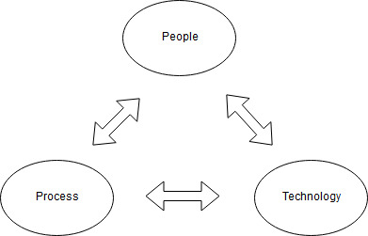
IT Systems Management
Organizational Management Approaches
People-Process-Technology Approach
People - It refers to the human resource involved in IT system management process at higher level. It generally includes infrastructure managers, directors and CIOs.
Process - People involved at this level are system analysts, senior systems administrators and supervisors, who are typically involved with designing and implementing systems management processes and procedures.
Technology - This component deals with technical professionals such as system programmers, database administrators, operations analysts, network administrators and systems administrators, who are responsible for installing and maintaining systems.

Slide 21
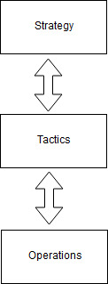
IT Systems Management
Organizational Management Approaches
Strategy-Tactics-Operations Approach
This is another commonly used approach for organizational management.
It consists of three important components, namely Strategy, Tactics and Operations (Figure below) and commonly identified by
acronym 'STO'.
Strategy - Long terms objectives of an organization are managed at strategic level. These objectives are defined in terms of value, identity,
relations prerequisite, choices, etc.
Tactics - Objectives set at strategy level are translated into specific
goals at this level.
Operations - Goals are translated into action plans at operational
level. Actual realization of goals happens at this level.

Slide 22
IT Service Management Process
This IT service refers to the delivery of information processing capabilities at an agreed quality level using a combination of software, hardware, people, networks, etc.
The way IT organizations serve their customers and the quality and value of the services they offer to their customers, continues to be a focus for companies worldwide.
Quality can be defined in terms of capacity, security, availability of services, performance, etc.
To deliver the IT services to the end user at agreed quality level, it is required that all processes engaged in providing services should be managed properly.
IT service management is the overall methodology for linking the various management processes necessary to ensure consistent supply of quality IT services.
It emphasizes customer-centric approach of IT management and business interaction in contrast to the technology-centric approaches.
IT service management focuses on the quality of services that an organization offers and concentrates on the relationship of the organization with the customers rather than only focusing on technology and organizational issues.

Slide 23
IT Service Management Process
In the current business scenario, it has become an integral part of an organization and is seen as an innovative way which can be used to prove the business value of IT services to cut costs and improve service quality.
IT service management needs an effective mechanism which allows the effective interaction of IT personnel with users of their services.
The main goals of IT service management is to align IT services with the critical needs of the business to manage services to ensure appropriate IT support for critical business priorities to minimize Total Cost of Ownership (TCO)* and to improve Return on Investment (ROI)*.
These goals of are summarized below:
Customer Centric - IT service management tries to align IT services with the needs of the business and its customers.
It is intended to ensure that IT services offered by an organization are aligned with the needs of customers and users.
It is the management of all people, processes and technology that cooperates to ensure the quality of IT services, according to the levels of service agreed with the customer.
*TCO is defined as the total cost of an IT asset throughout its lifecycle, right from its acquisition to its disposal.
*ROI is a performance measure used to evaluate the efficiency of an investment.

Slide 24
IT Service Management Process
These goals of are summarized below:
Availability and Stability of Services - It also deals with improving the availability and stability of the services.
It consistently tries to improve the quality of the services delivered.
Improved Communication - For a business to grow, customer satisfaction is very necessary.
IT service management puts a support system which allows the effective interaction of IT personnel within IT organization and with its users.
Efficiency of Internal Processes - IT service management works towards improving the efficiency of internal processes.
Cost of Services - IT service management makes the offered services cost effective.
It persistently tries to reduce the cost of the services and improve the quality of services provided by the organization.

Slide 25
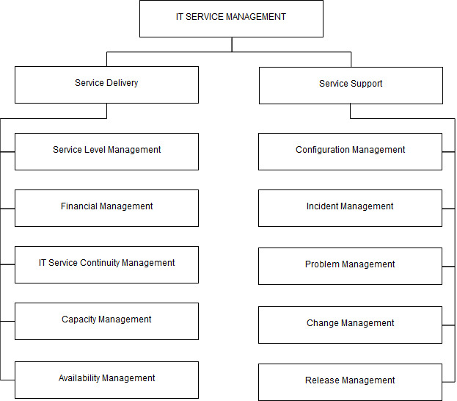
IT Service Management Process
IT service management is divided into two parts: Service delivery and Service support. The below figure shows various parts and subparts of IT service management process.

Slide 26
IT Service Management Process
SERVICE DELIVERY
Service delivery refers to the management of the IT services.
It involves a number of management practices to ensure that IT services are actually provided as agreed between the service provider and the customer.
These management practices are discussed briefly here.
Service Level Management
It offers service-delivery management across business units and helps in successfully delivering, maintaining and improving IT services up to the expected level through a constant cycle of agreeing, monitoring and reporting to meet the customers requirements and objectives.
Major steps that are followed in implementation of service level management are preparing service catalogue, defining service and operational level agreements and formulating service quality plan.

Slide 27
IT Service Management Process
SERVICE DELIVERY - Financial Management
Its main emphasis is on managing the monetary resources of an IT organization to achieve organizational goals.
It offers cost-effective management of the IT assets and resources used in providing IT services.
A good financial management process greatly helps IT managers in making decisions for planning and investment.
Usually, financial management activities includes IT cost accounting, budgeting for IT services and activities, project investment appraisal, cost recovery and IT charging and billing activities.
SERVICE DELIVERY - IT Service Continuity Management
Business organizations are expected to continue to operate and provide services in an uninterrupted fashion.
IT service continuity management process helps them in this regard and ensures that all IT services are capable of providing value to the customer in an event when normal availability of solutions fail.
Notes:
The purpose of investment appraisal is to assess the viability of project, program or portfolio decisions and the value they generate. Investment appraisal techniques are payback period, internal rate of return, net present value, accounting rate of return, and profitability index.
managing the monetary resources of an IT organization
cost-effective management
financial management process
IT cost accounting, budgeting for IT services and activities, project investment appraisal, cost recovery and IT charging and billing activities.

Slide 28
IT Service Management Process
SERVICE DELIVERY - IT Service Continuity Management
It manages risks and ensures that an IT infrastructure of an organization can continue to provide services in an unlikely or unexpected event.
Major processes involved in IT service continuity management are collection of service level requirements, proposing contingent solution, formalizing operation level agreement and formalizing contingency plan.
SERVICE DELIVERY - Capacity Management
Prime objective of capacity management is to ensure that IT capacity meets current and future business requirements of an organization in a cost-effective manner and IT infrastructure of the organization is used in an efficient manner.
Capacity management involves planning, analyzing, sizing and optimizing capacity to fulfill the demand in a timely manner and at a reasonable cost.

Slide 29
IT Service Management Process
SERVICE DELIVERY - Availability Management
The goal of availability management is to ensure that all IT services deliver the level of availability that the customer requires consistently and cost-effectively.
It optimizes the capability of the IT infrastructure services and supporting organization to deliver a cost-effective and sustainable service availability that meets stringent business objectives.
Processes involved in availability management are defining service level requirements, proposing availability solutions and formalizing operational level agreements.

Slide 30
IT Service Management Process
SERVICE SUPPORT
It talks about a framework that enables effective IT services.
Various management practices involved in service support are discussed here briefly.
Configuration Management
It deals with identifying and defining configuration items in a system and further monitoring the status of these items, processing requests for change and verifying the completeness and correctness of configuration items.
Configuration management offers a logical model of the IT infrastructure by identifying, maintaining and verifying the version of all configuration items.
Configuration management is mainly responsible for identifying configuration items, finding relationship among configuration items and planning, designing and managing a Configuration Management Database (CMDB).

Slide 31
IT Service Management Process
SERVICE SUPPORT - Incident Management
The goal of incident management is to ensure that restoration of normal service operations is done as quickly as possible with the least possible impact on either the business or the user and minimum interruption in services, in a cost-effective way.
It helps in maintaining continuity of the service levels and underlying service desk function.
SERVICE SUPPORT - Problem Management
It ensures that all possible problems and known errors affecting the IT infrastructure are identified and recorded properly.
It investigates and resolves the underlying root causes of incidents and prevents similar incidents from happening again.
Problem management also provides valuable inputs such as recording problems and known errors to other service management processes like incident management, change management and service desk.
The major activities of problem management includes problem control, error control and report generation.

Slide 32
IT Service Management Process
SERVICE SUPPORT - Change Management
The goal of change management is to ensure standardization of methods and procedures so that it minimizes the impact of any change on service quality.
It offers a way to introduce the required changes to the IT environment with minimal disruption to ongoing operations.
Change management offers reduced impact of changes, better cost estimation of changes, better information management of changes and improved personnel productivity.
SERVICE SUPPORT - Release Management
The objective of release management is to formulate efficient mechanisms of building and releasing new software versions.
Release management ensures the quality of the production environment by using formal procedures and checks while implementing new versions.

Slide 33
IT Service Management Process
SERVICE SUPPORT - Release Management
Release management is responsible for activities such as planning, coordination and implementation, designing and implementation of efficient procedures for the distribution and installation of changes to IT systems, management of release of software into the live environment and its distribution, gathering users' feedback and maintaining Definitive Software Library (DSL) and Configuration Management Database (CMDB).

Slide 34
Information System Design Process
The basic objective of the information system design is to create a customized instance of the IT system architecture from a basic model.
A commonly accepted practice for designing an IT system architecture is to use a model of the business processes as the starting point and then subsequently to refine it using a step-by-step process by following selected computing paradigms, such as custom client-server, internet computing and so on.
This kind of design process is commonly known as business process centric design processes.
This design process has two types of requirements: Functional and Non-Functional.
Functional requirements describe the behaviours (functions and services) of the system that support user goals, tasks or activities.
Non-functional requirements consist of those requirements that specify criterion that can be employed to judge the operation of a system, rather than specific behaviours.
These requirements include those for systems management to include performance, availability and security.

Slide 35
Information System Design Process
These requirements are often treated as secondary considerations while designing.
It is thought that they influence, but do not overly constrain the design or deployment of the IT solution.
Due to this, the business process may not comprise adequate operational support for systems management.
To have a good design, there is a need to develop views and visualisation techniques to combine the design requirements for business processes and system management involved in those processes.
Design Models
Models in IT system design can be represented in many ways. There are three popular and relevant system models discussed below:
Business processes based model: It is a business system model that represents the business processes. These models deal with the representation of processes involved in a business. The main goal behind business process modeling is to analyze the current processes and suggest future improvements. It is usually performed by business analysts and managers who are looking for improvements in process quality and efficiency.

Slide 36
Information System Design Process
Design Models
Models in IT system design can be represented in many ways. There are three popular and relevant system models discussed below:
Management activities based model: It is a business system model that represents the management activities which support the business processes.
Hybrid model: It is business system model that combines both business processes and IT management processes.
System Context Diagram
A system context diagram provides the highest level view of a system and is used to specify details of a system design.
It is used in systems design to represent all external entities that may intersect with a system.
It gives a convenient representation for a system model.
System context diagram is similar to block diagram and normally shows a software-based system as a whole, and its inputs and outputs from/to external factors.

Slide 37
Information System Design Process
System Context Diagram
System context diagrams are also related to data flow diagrams and help in understanding the context in which the system is part of.
System Context Diagrams are typically drawn using labeled boxes to represent each of the external entities and an additional labeled box to represent the system being developed.
The relationship between entities and the developed system is shown using lines.
The main system in system context diagram is kept at its centre with no details of its interior structure and all its interacting systems, environment and activities surrounding it.
The relationships are labeled with a subject-verb-object format, for example, "customer places order".
System context diagrams can also use many other different drawing types such as ovals, stick figures, pictures, clip art or any other representation to convey meaning and represent external entities.
Unified Modeling Language (UML) is a standardized formal visual specification language for object modeling and frequently used for drawing system context diagrams.

Slide 38
Information System Design Process
System Context Diagram
It is a general-purpose modeling language which includes a graphical notation used to create an abstract model of a system, referred to as a UML model.
UML defines several standard representations for architecture elaboration, to name a few - use-case diagrams, collaboration diagrams, class diagrams, sequence diagrams, component and deployment diagrams.
A system context diagram follows the structure of use-case diagram.
Use-Case Diagram
It is used to identify the primary elements and processes that form the system.
The primary elements are called actors and the processes are called use-cases.
The use-case diagram shows which actors interact with each use-case.
It gives a graphical overview of the functionality provided by a system in terms of actors, their goals (depicted as use cases), and the dependencies between those use cases.
When we adopt process view of system management, use-case diagrams becomes a very important tool in explaining the workflow of business processes and activities associated with IT management.

Slide 39
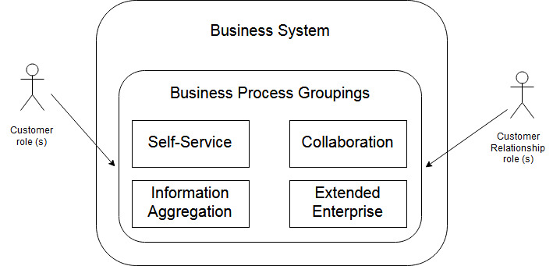
Information System Design Process
System Context Diagram
Business System Context Diagrams
It is used to identify a business system which involves a set of business processes.
These business processes fall into four categories - Self-service, Collaboration, Information aggregation, and extended enterprise.
The below figure shows an example of a business system context diagram.

Slide 40
Information System Design Process
System Context Diagram
Business System Context Diagrams
This diagram can be used as a starting point on which more detailed elaboration for the subject business system can be built.
For example, in a business environment, commerce portal can be considered as extended enterprise process, customer account management application can be considered as self-service process, e-mail system can be considered as collaboration process, and market support application can be considered as an information aggregation process.
This business system model comprises of two roles: One for customers and other for customer relationship personnel.

Slide 41
Information System Design Process
System Context Diagram
IT Management System Context Diagrams
The concept of business system context diagram can be extended to define IT management system context diagram which identifies an IT system that contains a set of IT management processes.
The figure below shows an example of IT management system context diagram where IT management processes are clubbed into eight groups.
Similar to business system context diagram, IT management system context diagram can be used as a starting point based on which an elaboration can be developed for the subject IT management system.
For example, IT management system context diagram can be used to identify the following:
- How systems' designs are developed, deployed and operated
- How administration of an IT system is done
- How customer relationships are set up and sustained
- How the availability is maintained.

Slide 42
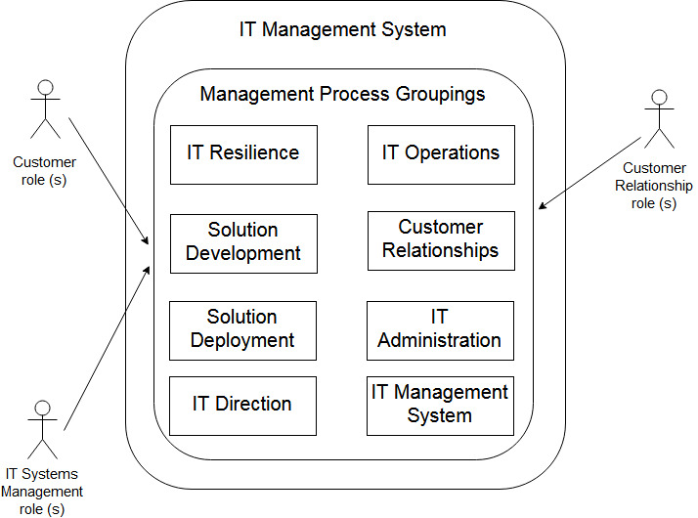
Information System Design Process
System Context Diagram
IT Management System Context Diagrams

Slide 43
Information System Design Process
System Context Diagram
Managed Business System Context Diagram
There is a natural possibility of combining the business and IT management views of the system.
The managed business system model integrates business and management aspects of the system.
Managed business system context diagram is used to represent such business models.
Business aspect is described as the functional view of the solution whereas management aspect is described as the non-functional view of the solution.
The combined process model shown in below figure is a composite view of the two previous models.
It can be observed that the managed business system is divided into a business application domain and a management domain.
In the business and IT management combined process model, there are three types of roles viz. one for customers, one for IT management personnel and other one for customer relationship personnel.

Slide 44
Information System Design Process
System Context Diagram
Managed Business System Context Diagram
Managed business systems can be very complex with respect to following aspects:
-All of the management activities and tasks required to support the operation
-Maintenance and management of the necessary business process
-Operation, maintenance and management of the IT infrastructure that supports the business process.

Slide 45
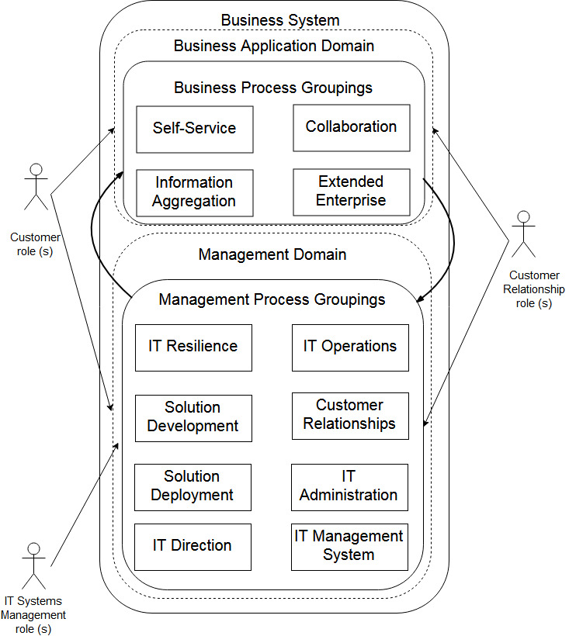
Information System Design Process
System Context Diagram
Managed Business System Context
Diagram

Slide 46
IT Infrastructure Library
IT organisations are continuously enforced to deliver better IT services at lower cost.
To provide guidelines to achieve this goal and cope up with the stringent challenges, several management frameworks have been developed; one of the best known frameworks is the Information Technology Infrastructure Library (ITIL).
It is the most widely accepted approach to IT service management worldwide.
It is a customizable framework of best practices developed to promote quality services in the IT sector.
Developed in the late 1980s by the CCTA (now known as OGC) (CCTA - Central Computer and Telecommunications Agency) (OGC - Office of Government Commerce), it became popular worldwide and de facto standard in service management in mid 1990s.
It was originally designed to serve as a set of standards to be followed by service providers to deliver IT services to the British government.
After its inception, public companies have realised the benefits and implemented parts of ITIL in their internal IT departments.
ITIL has now become acceptable to almost everyone as it is a public domain framework with scalable property.

Slide 47
IT Infrastructure Library
As an IT service management framework, ITIL provides a systematic approach to manage IT services, from their inception through design, implementation, operation and continual improvement.
The processes identified and described within ITIL are supplier and platform independent and apply to all aspects of IT infrastructure.
ITIL consists of set of concepts, policies and practices used for managing IT infrastructure, development and operations.
It provides a comprehensive description of a number of important IT practices with detailed catalogue, procedures and tasks that an IT organisation can adapt for its need.
It provides business with a customizable framework of best practices to achieve quality service and overcome problems associated with the growth of IT systems.
ITIL is published in a series of books, each of which give details of an IT management topic. ITIL has grown up to three versions by now.
ITIL version 1 - It is the initial version of IT infrastructure library which has expanded over 30 volumes.
At the beginning, ITIL version 1 was projected as a set of formal methods, which was later changed and published as set of guidelines.

Slide 48
IT Infrastructure Library
ITIL version 2 - Originally, the ITIL was published as a collection of series of books, each of which covered a particular practice of IT service management.
Number of books in the initial publication of ITIL (ITIL version 1) has grown up to 31 volumes.
To make ITIL more approachable and financially manageable, ITIL version 2 consolidates the volumes of ITIL version 1 into logical sets by grouping the related process guidelines of IT management, applications, and services.
The eight book volumes of ITIL version 2 are grouped into three parts as follows:
1. The IT service management set
- Service delivery
- Service support
2. Operational guidance set
- ICT infrastructure management
- Security management
- The business perspective
- Application management
- Software Asset management

Slide 49
IT Infrastructure Library
The eight book volumes of ITIL version 2 are grouped into three parts as follows:
3. Implementation guidelines set
- Planning to implement service management
4. Supplementary set
- ITIL small-scale implementation (it has been published later, not part of original eight publications)

Slide 50
IT Infrastructure Library
ITIL version 3 - It updates the ITIL version 2 by expanding the scope of ITIL in the domain of service management.
ITIL version 3 comprises of five key volumes which are listed below:
Service Strategy
This volume is the main strength of the new ITIL library which focuses on helping IT organisations to improve and develop over the long term.
It introduces the service lifecycle and encourages the development of a business perspective.
This volume guides both the service provider as well as the business customer, through choices that they need to achieve service excellence.
The key topics which are present in this volume include business case development, service assets, service value definition, market analysis and service provider types.
The processes which are included are IT financial management, service portfolio management and demand management.

Slide 51
IT Infrastructure Library
ITIL version 3 - ITIL version 3 comprises of five key volumes which are listed below:
Service Design
This volume provides good practice guidance on design of IT services and processes to create valuable IT service assets for an organisation within business constraints such as time and money.
It gives a framework for service design which considers the customer's present and future requirements, while firmly maintaining the business view.
Processes which are included in this volume are service level management, capacity management, availability management, IT service continuity management, supplier management, information security management and service catalogue management.
Service Transition
This ITIL volume provides guidance on managing the many aspects of service changes, preventing undesired consequences while allowing for innovation.
It is essential reading for anyone seeking to deliver IT change with the best possible benefit to the business.
Topics covered in the volume are transition planning and support, service asset and configuration management and change management, release and deployment management and knowledge management.
It also states the key roles and responsibilities of staff involved in service transition.

Slide 52
IT Infrastructure Library
ITIL version 3 - ITIL version 3 comprises of five key volumes which are listed below:
Service Operation
This volume introduces delivery and control activities are to support high quality service operations.
It covers best practices for balancing conflicting goals (such as reliability vs cost), problem management, event management, incident management, service desk, asset management, technical and application management.
It also defines the key roles and responsibilities for staff involved in service operation.
Continual Service Improvement
Improvements in service quality enables the business to survive in a competitive environment and helps in achieving the best possible outcomes.
This volume introduces the processes involved in identifying and introducing a cycle of service management improvements.
The goal of continual service improvement is to align and realign IT services to changes in business needs by identifying and implementing improvements to the IT services (such as service quality, process effectiveness, efficiency and cost effectiveness) that support the business processes.

Slide 53
IT Infrastructure Library
Alternatives to ITIL
Although ITIL is the most popular IT service management guideline, it is not the only approach which is available for standardizing IT service operations.
IT service management is a concept and though related to ITIL, it is not completely equivalent to ITIL.
As mentioned in ITIL version 2, only a subsection of it - entitled IT service management - talks about the IT service aspects.
Moreover, ITIL version 3 volumes do not have any separate description on it.
There are some other alternatives to ITIL such as Microsoft Operations Framework and ISO/IEC 20000.
The following discussion provides brief discussion on them.
Microsoft Operations Framework
Goal of every business process is to provide better services at lower cost.
The Microsoft Operations Framework (MOF) helps to achieve the same.
It aims to help its customers in achieving operational excellence across the entire IT service lifecycle.

Slide 54
IT Infrastructure Library
Alternatives to ITIL
The following discussion provides brief discussion on them.
Microsoft Operations Framework
Originally it was developed to provide IT professionals with knowledge and processes required to align their work in managing Microsoft platforms cost-effectively and with high reliability.
Newer version of MOF (MOF 4.0) offers its customers new ways to cope up with the new challenges in providing better IT services.
It provides practical guidelines for each and every day-to-day activity and helps in maintaining the regulatory requirements for enhancing organizational capabilities.
IT Service Lifecycle of MOF
It is comprised of three phases and one manage layer as shown in below figure.
Manage layer operates throughout the cycle of other three phases and works as the foundation of IT service lifecycle and covers the components that apply to all lifecycle phases.

Slide 55
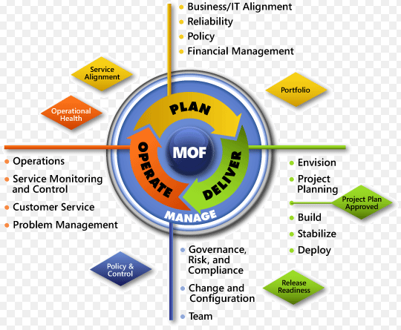
IT Infrastructure Library
Alternatives to ITIL

Slide 56
IT Infrastructure Library
Alternatives to ITIL
The following discussion provides brief discussion on them.
IT Service Lifecycle of MOF
These three phases and foundation layer are explained below.
Plan Phase
The task of this phase is to plan and optimize an IT service strategy so that the set business objectives can be achieved.
- Deliver Phase: It ensures that IT services are developed and deployed successfully and are ready for operations.
- Operate Phase: This phase is responsible to ensure that IT services are operated, maintained and supported effectively to meet business objectives and expectations.
- Manage Layer: This layer is the foundation of the IT service lifecycle and proesses in this layer apply to all phases of the lifecycle.
- It is responsible for IT governance, risk management, change management, configuration management, etc.

Slide 57
IT Infrastructure Library
Alternatives to ITIL
The following discussion provides brief discussion on them.
IT Service Lifecycle of MOF - Plan Phase
To align IT services to the business requirement, each phase of the IT service lifecycle contains Service Management Functions (SMFs).
These SMFs define and structure the processes, people, and activities required.
Each SMF has three to six key processes and each process has one to six key activities.
ISO/IEC 20000
It is the first international standard IT service management which is referred to as combination of service support and service delivery volumes of ITIL version 2.
ISO/IEC 20000 was originally developed to reflect best practices of ITIL.
It equally supports other IT service management frameworks such as Microsoft Operations Framework, components of ISACA's CobIT framework, etc.
ISO/IEC 20000 IT service management standard consists of two parts - the first part contains a specification for IT service management whereas second one defines the code of practice for service management.

Slide 58
Reference
P.Gupta, “ IT Infrastructure and Its Management” 2nd Reprint, 2010, Tata McGraw Hill, ISBN: 978-0070699793

